Slide 1

Opening a new Chinese Restaurant in Bucharest, Romania
Alhassan Abdul-Mumin

Slide 2
INTRODUCTION
Chinese cuisine takes centre stage across the world. For centuries, the influence of China has been felt across the globe. But the Asian superpower’s growing authority doesn’t only affect the economy: China’s impressive presence is also having an impact on culinary habits. China’s emergence as a global economic powerhouse has led to it having financial interests across the face of the world. Investments range from African natural resources. This has led to the emergence of many Chinese restaurants in Europe and in Romania. As a result, one has to take pragmatic steps in opening a new Chinese restaurant in Romania in order to succeed and outlive competition. We try to group the neighborhoods of Bucharest, Romania and draw insights to where best to open a Chinese restaurant.

Slide 3
BUSINESS PROBLEM
The aim is to help investors choose the best neighborhood to establish a Chinese restaurant to generate optimum profit. This also helps investors and similar organizations make decisions if they are thinking about opening other restaurants in other location in the country or even if they want to relocate neighbourhoods within the city. Our findings will help stakeholders make informed decisions and address any concerns they have including the different kinds of cuisines, provision stores and what the city has to offer.

Slide 4
DATA COLLECTION, DESCRIPTION AND ANALYSIS
First of all we will try to convert address data into their equivalent latitude and longitude values. For Bucharest neighborhood data, I will use Wikipedia, https://en.wikipedia.org/wiki/Category:Districts of Bucharest. We will go use the Foursquare API to explore Bucharest neighborhoods and to get venues in neighborhoods. We will use the Foursquare API to get venue ratings and likes in neighborhoods, use the k-means clustering and Agglomerative algorithms to complete clustering task, and use the Folium library to visualize the neighborhoods, venues, clusters in Bucharest

Slide 5
METHODOLOGY
We will be creating our model with the help of Python so we start off by importing all the required packages.
import requests
import numpy as np
import matplotlib.cm as cm
import matplotlib.colors as colors
import folium
from sklearn.cluster import KMeans
Package breakdown:
• Pandas : To collect and manipulate data in JSON and HTMl and then data analysis
• requests : Handle http requests
• matplotlib : Detailing the generated maps
• folium : Generating maps of London and Paris
• sklearn : To import K means which is the machine learning model that we are using.
The approach taken here is to explore each of the sectors of the city individually, plot the map to show the neighbourhoods being considered and then build our model by clustering all of the similar neighbourhoods together and finally plot the new map with the clustered neighbourhoods. We draw insights and then compare and discuss our findings.

Slide 6
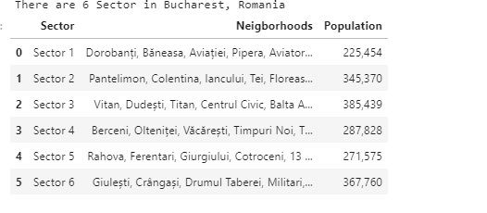
Get sector of neighborhood and population of sector

Slide 7
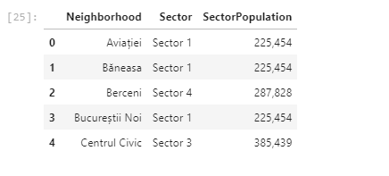
Set sector of neighborhoods

Slide 8
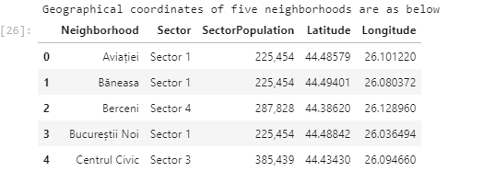
Get geographical coordinates of neighborhoods

Slide 9
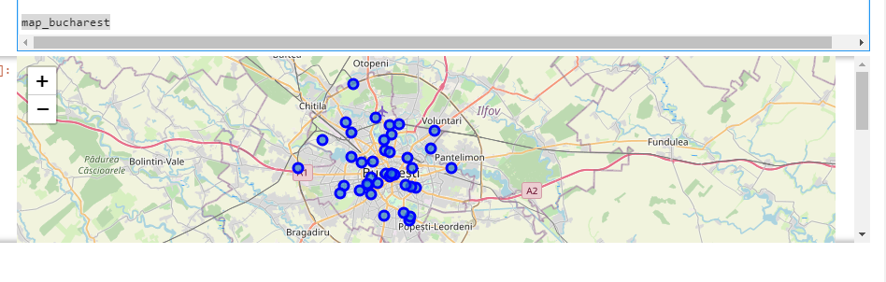
Create Bucharest map with neighborhoods superimposed

Slide 10
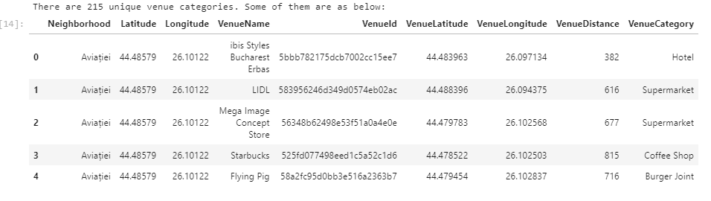
Explore Venues of Bucharest neighborhoods

Slide 11
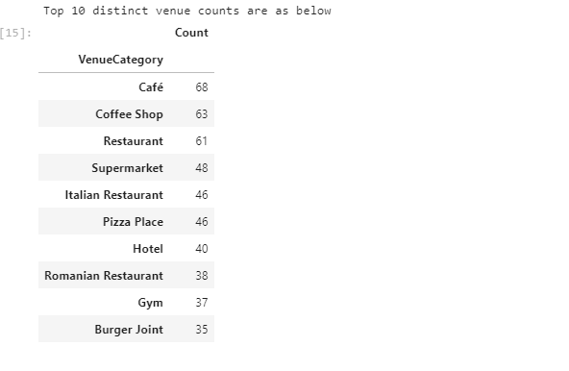
Top 10 distinct venue counts are as below

Slide 12

Filter restaurants out of all venues

Slide 13
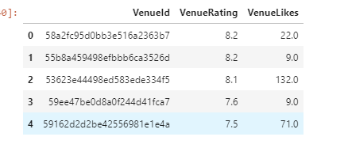
Get the restaurant's overall rating

Slide 14
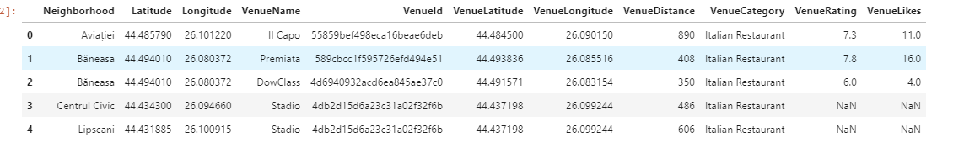
Get the restaurant's overall rating

Slide 15
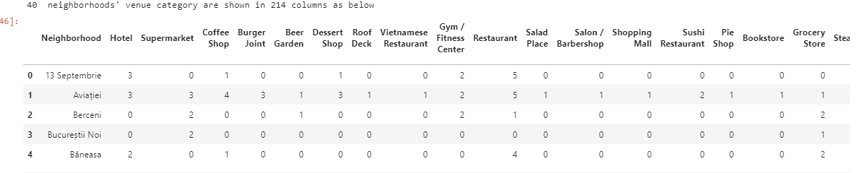
Cluster Neigborhoods using Agglomerative Clustering

Slide 16
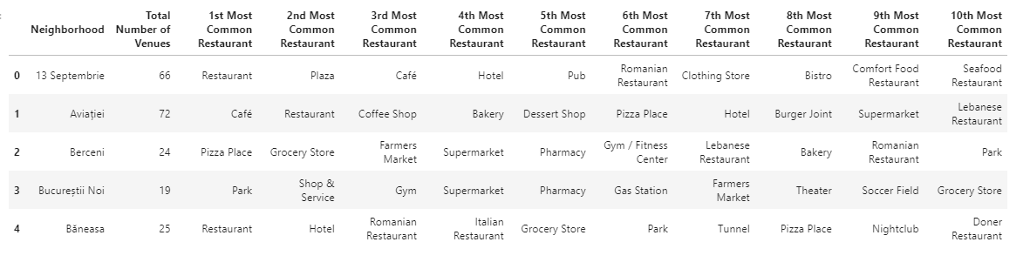
Cluster Neigborhoods using Agglomerative Clustering

Slide 17
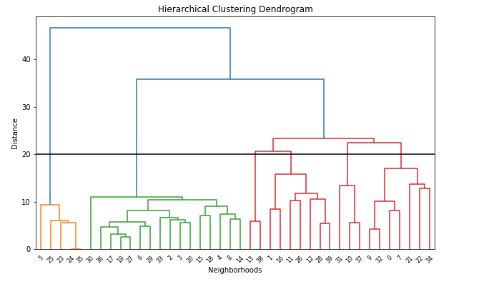
Cluster and find similarities between neighborhoods

Slide 18
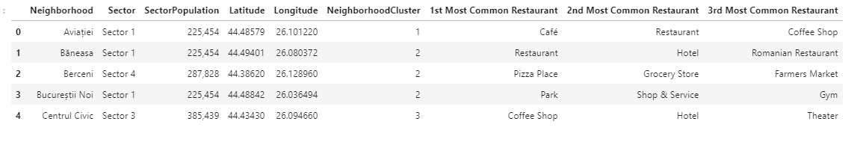
Cluster and find similarities between neighborhoods

Slide 19
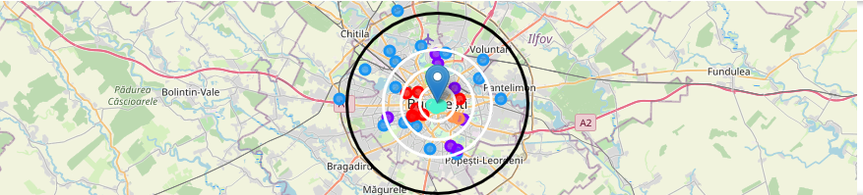
Cluster and find similarities between neighborhoods
Cluster 0 (Red) : Italian Restaurant , Pizza, Café
Cluster 1 (Purple) : Restaurant , Bar
Cluster 2 (BLue) : Park , Plaza, Clothing stores
Cluster 3 (Cyan) : Coffee Shop, Hotel, Pub
Cluster 4 (Green) : Café, Suprmarket
Cluster 5 (Orange) : Café

Slide 20
Discussion
Cluster 2 suffers from restaurant. Especially there is no Chinese restaurant in west part inluding Cluster 2 . We can think about Cluster 2 , West part
Cluster 0 especially likes Itallian tastes , may be this part will not like Turkish tastes . We can only think about 1 location may be .
Cluster 1, 2, 3 are centers full of restaurants as we saw in the heatmap also

Slide 21
Conclusion
Possible Neighborhoods to set up a Chinese restaurant :
• Neighborhood : Regie , Cluster 0, Sector 6 , Population : 367760
I choosed Regie , since west part of Bucharest has not Chinese restaurant and Regie is close to center . Regie is red cluster which is same with the other 2 red markers having Chinese restaurant. Red clusters populations may like Chinese food.
• Neighborhood : Bucureștii Noi , Cluster 2, Sector 1 , Population : 225453
I choosed Bucharest-noi , since west part of Bucharest has not Chinese restaurant and even not too much restaurant after 6 km distance to center . One restaurant will be good for this area.
• Neighborhood : Crângași , Cluster 2, Sector 6 , Population : 367760
I choosed Crangasi , since Crangasi and west part of Bucharest has not Chinese restaurant and from bar chart we can see that this neighborhood has not too much restaurant. Also this neighborhood is in Sector 6 and this sector has biggest population which will handle one more restaurant
• Neighborhood : Tineretului , Cluster 2, Sector 4 , Population : 287828
I choosed Tineretului , since Tineretului has not Chinese restaurant and from bar chart we can see that this neighborhood has not too much restaurant.

Slide 22
THANK YOU

